Slide 1
Reinforced concrete structures
Doubly Reinforced Beams

Slide 2
What is doubly reinforced beam?
A double reinforced concrete section is reinforced in both compression and tension regions.

Slide 3
When depth of the section is restricted, the strength available from a singly reinforced section is inadequate.
At a support of a continuous beam where bending moments changes sign. In such a situation may also arise in the design of a doubly reinforced beam.
What is the necessity of using steel in compression region?

Slide 4
Analysis of section
Analysis involves the determination of the amount of moment of resistance knowing the breadth, depth, area of tension and compression steel and their clear cover.
Analysis is similar to that for the singly reinforced section except that the compression force consists of two parts : (i) in steel and (ii) in compression

Slide 5
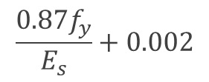
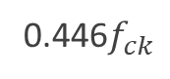
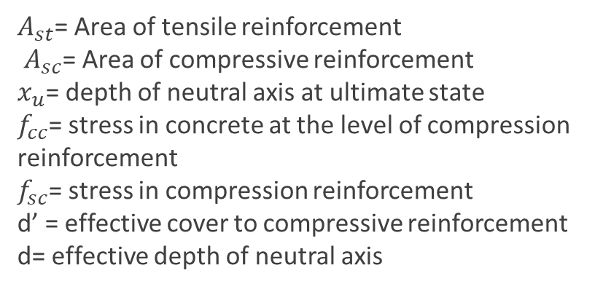
b
0.0035
0.446$f_{ck}$
d’
C
d
d – d’
T
$$\frac{0.87f_{y}}{E_{s}}+0.002$$
Strain
Diagram
Stress Diagram
$A_{st}$= Area of tensile reinforcement
$A_{sc}$= Area of compressive reinforcement
$x_{u}$= depth of neutral axis at ultimate state
$f_{cc}$= stress in concrete at the level of compression reinforcement
$f_{sc}$= stress in compression reinforcement
d’ = effective cover to compressive reinforcement
d= effective depth of neutral axis

Slide 6
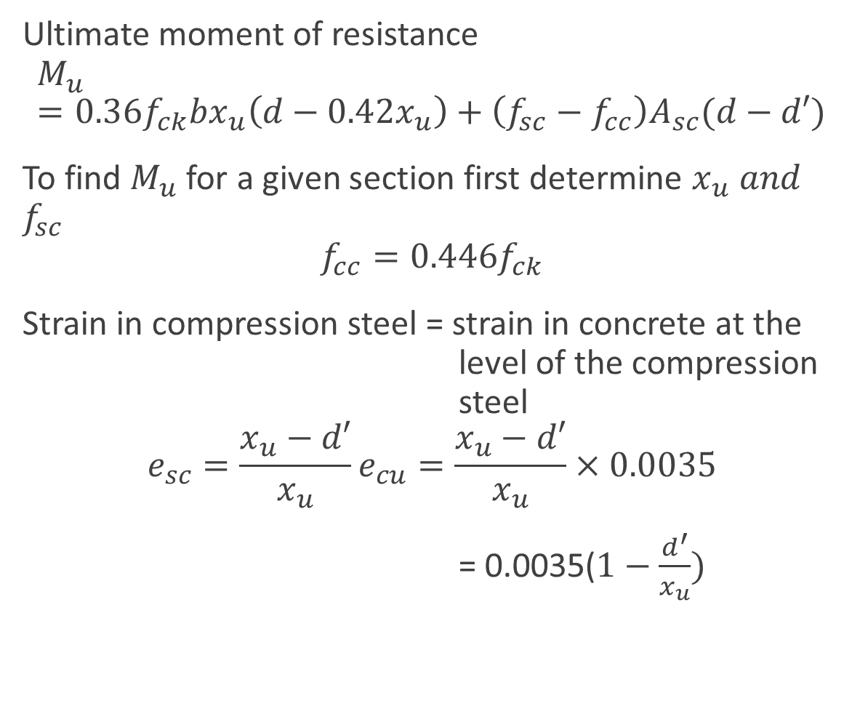
To find the moment of resistance for a beam section provided with a given compression and tension reinforcement
Ultimate moment of resistance
$$M_{u}=0.36f_{ck}bx_{u}\left(d−0.42x_{u}\right)+\left(f_{sc}−f_{cc}\right)A_{sc}(d−d′)$$
To find $M_{u}$ for a given section first determine $x_{u} and$ $f_{sc}$
$$f_{cc}=0.446f_{ck}$$
Strain in compression steel = strain in concrete at the level of the compression steel
$$e_{sc}=\frac{x_{u}−d′}{x_{u}}e_{cu}=\frac{x_{u}−d′}{x_{u}}×0.0035$$
= 0.0035($1−\frac{d^{′}}{x_{u}})$

Slide 7
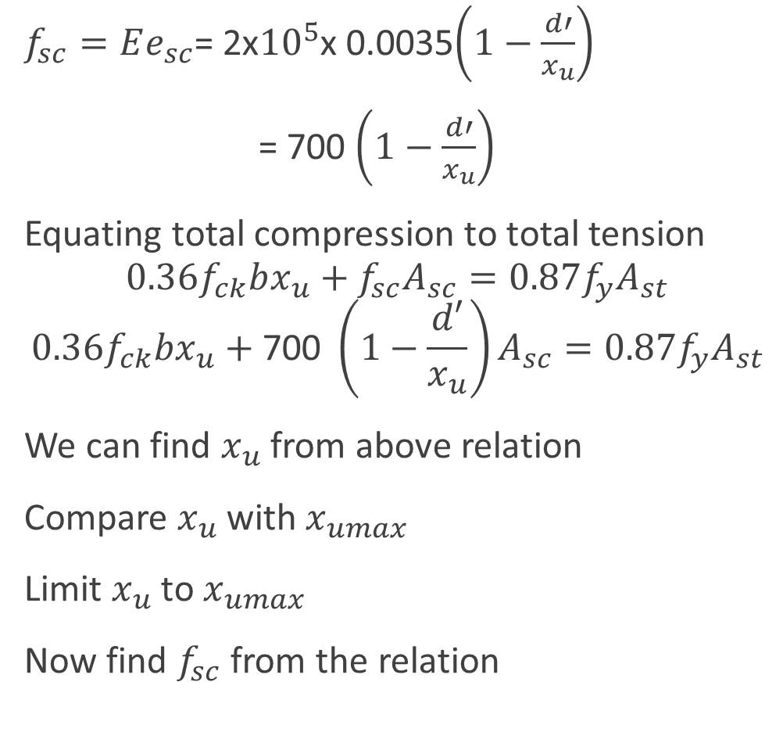
$f_{sc}=Ee_{sc}$= 2x${10}^{5}$x 0.0035$\left(1−\frac{d′}{x_{u}}\right)$
= 700 $\left(1−\frac{d′}{x_{u}}\right)$
Equating total compression to total tension
$$0.36f_{ck}bx_{u}+f_{sc}A_{sc}=0.87f_{y}A_{st}$$
$$0.36f_{ck}bx_{u}+\text{700 }\left(1−\frac{d′}{x_{u}}\right)A_{sc}=0.87f_{y}A_{st}$$
We can find $x_{u}$ from above relation
Compare $x_{u}$ with $x_{umax}$
Limit $x_{u}$ to $x_{umax}$
Now find $f_{sc}$ from the relation

Slide 8
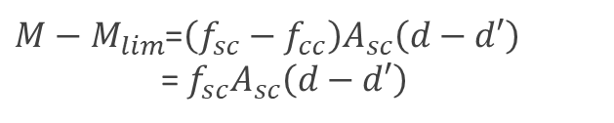
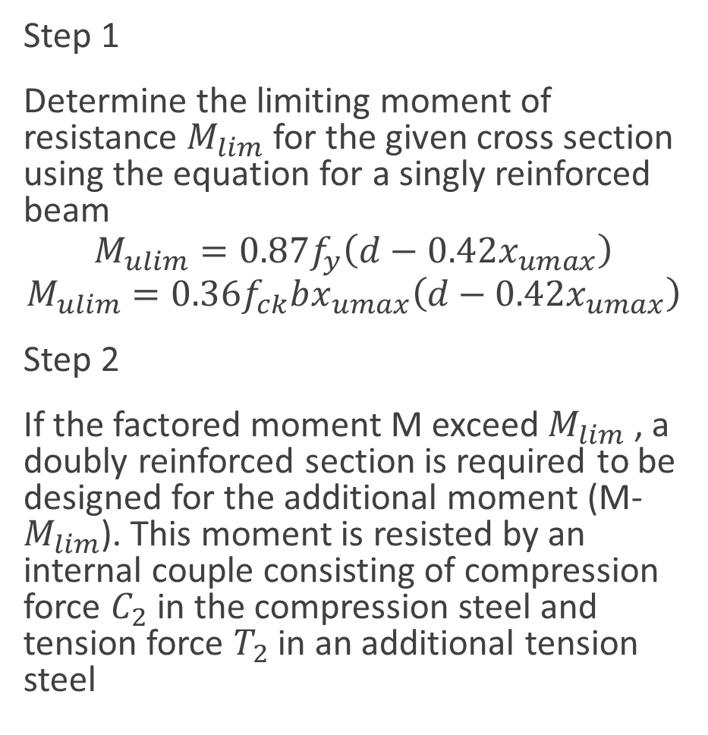
To design a doubly reinforced beam
Step 1
Determine the limiting moment of resistance $M_{lim}$ for the given cross section using the equation for a singly reinforced beam
$$M_{ulim}=0.87f_{y}\left(d−0.42x_{umax}\right)$$
$$M_{ulim}=0.36f_{ck}bx_{umax}\left(d−0.42x_{umax}\right)$$
Step 2
If the factored moment M exceed $M_{lim}$ , a doubly reinforced section is required to be designed for the additional moment (M- $M_{lim}$). This moment is resisted by an internal couple consisting of compression force $C_{2}$ in the compression steel and tension force $T_{2}$ in an additional tension steel
$M−M_{lim}$=$\left(f_{sc}−f_{cc}\right)A_{sc}\left(d−d′\right)$
= $f_{sc}A_{sc}\left(d−d′\right)$

Slide 9
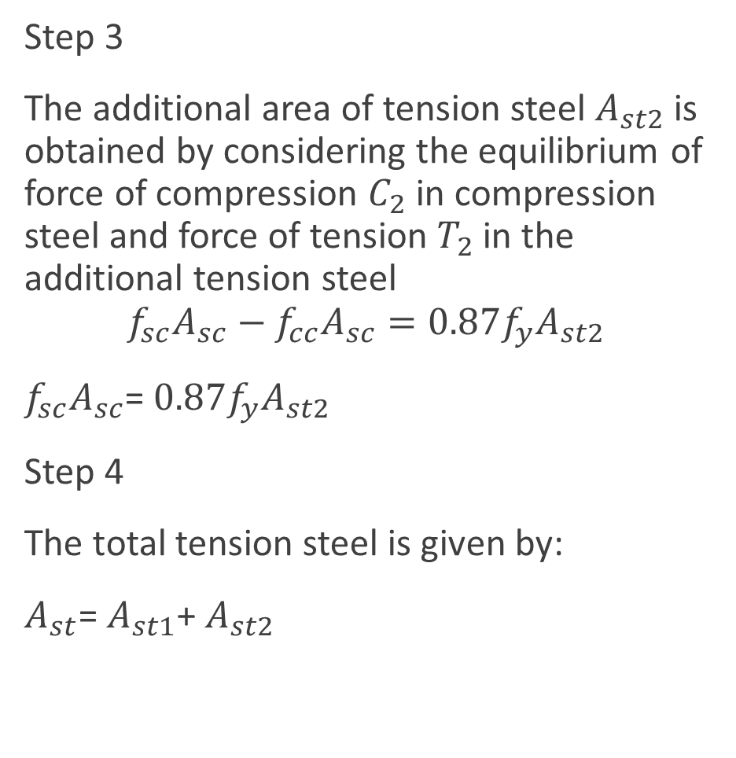
Step 3
The additional area of tension steel $A_{st2}$ is obtained by considering the equilibrium of force of compression $C_{2}$ in compression steel and force of tension $T_{2}$ in the additional tension steel
$$f_{sc}A_{sc}−f_{cc}A_{sc}=0.87f_{y}A_{st2}$$
$f_{sc}A_{sc}$= $0.87f_{y}A_{st2}$
Step 4
The total tension steel is given by:
$A_{st}$= $A_{st1}$+ $A_{st2}$

Slide 10
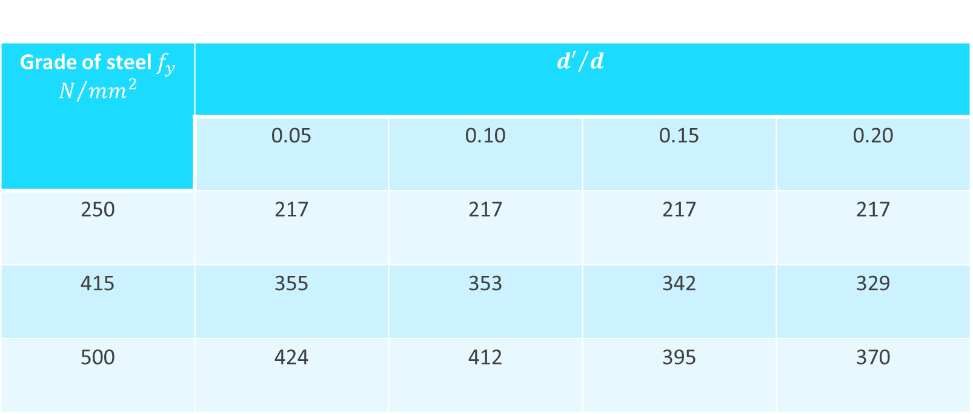
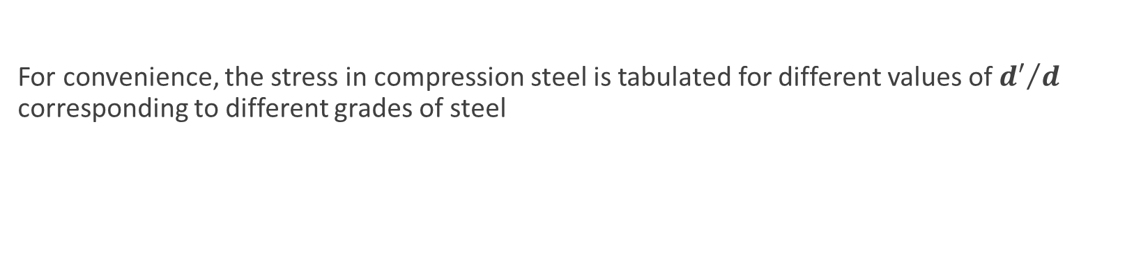
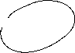
For convenience, the stress in compression steel is tabulated for different values of ${d′}/d$ corresponding to different grades of steel
Grade of steel $f_{y}$ $N/{{mm}^{2}}$ | $${d′}/d$$
 | 0.05 | 0.10 | 0.15 | 0.20
250 | 217 | 217 | 217 | 217
415 | 355 | 353 | 342 | 329
500 | 424 | 412 | 395 | 370

Slide 11
Reinforced concrete structures
Doubly Reinforced Beams

Slide 12
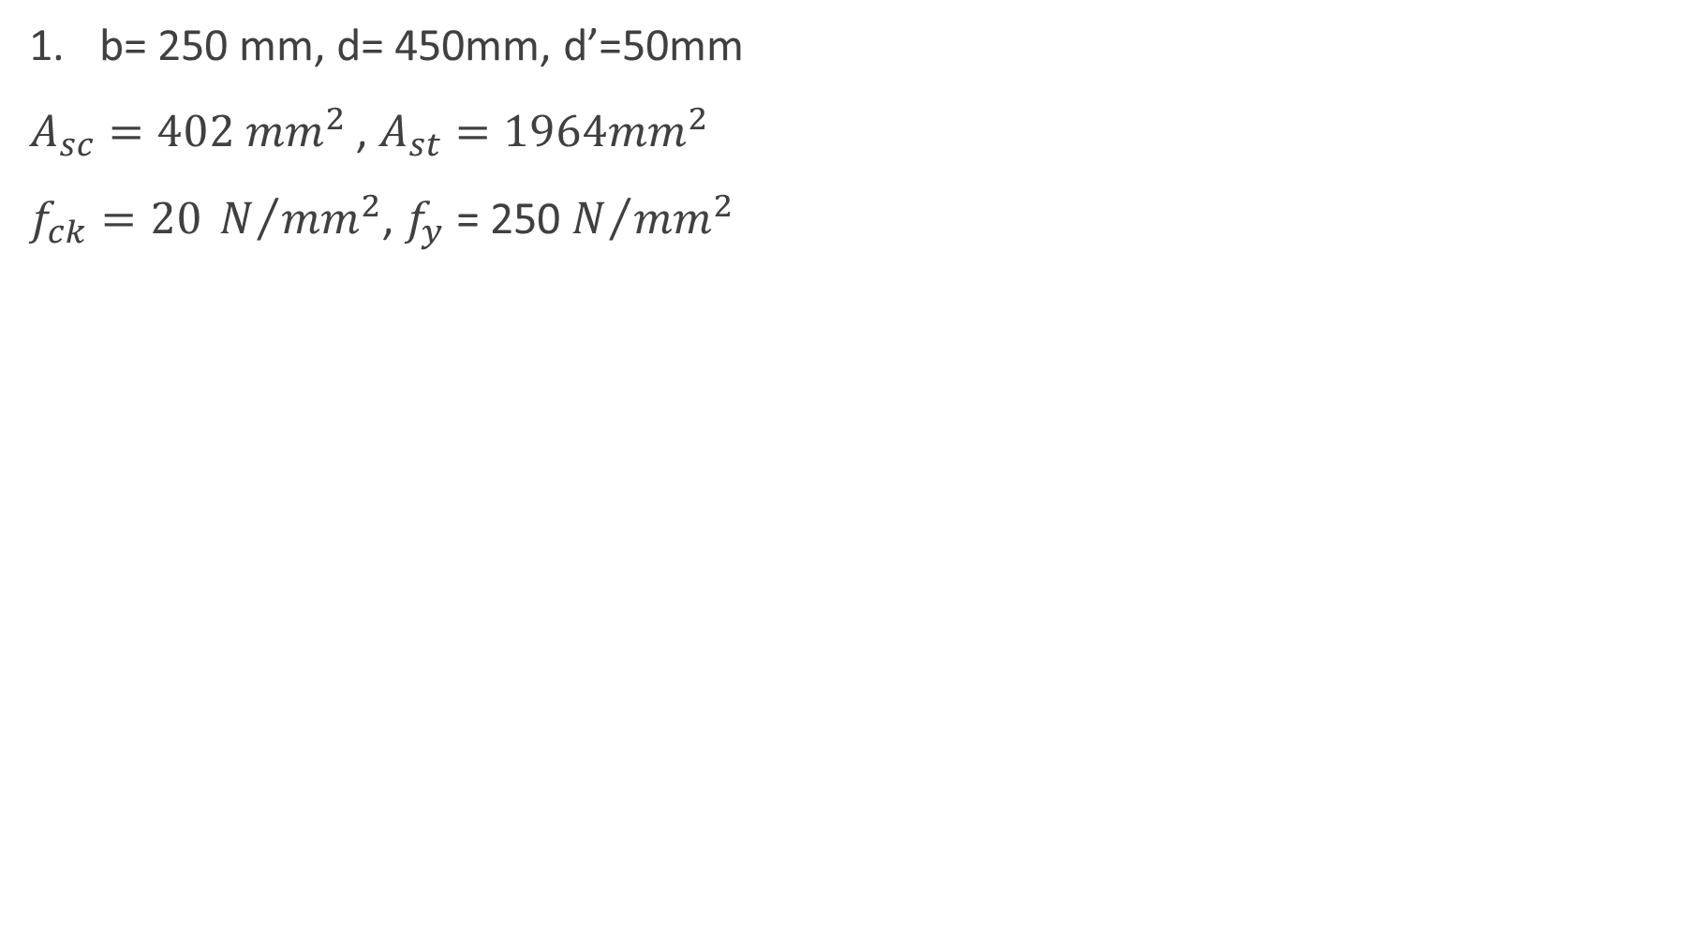

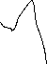
b= 250 mm, d= 450mm, d’=50mm
$A_{sc}=402 {mm}^{2}$ , $A_{st}=1964{mm}^{2}$
$f_{ck}=20 N/{{mm}^{2}}$, $f_{y}$ = 250 $N/{{mm}^{2}}$
d’
d
d – d’
2 bars of 16 mm as compression reinforcement
4 bars of 25 mm as tensile reinforcement

Slide 13
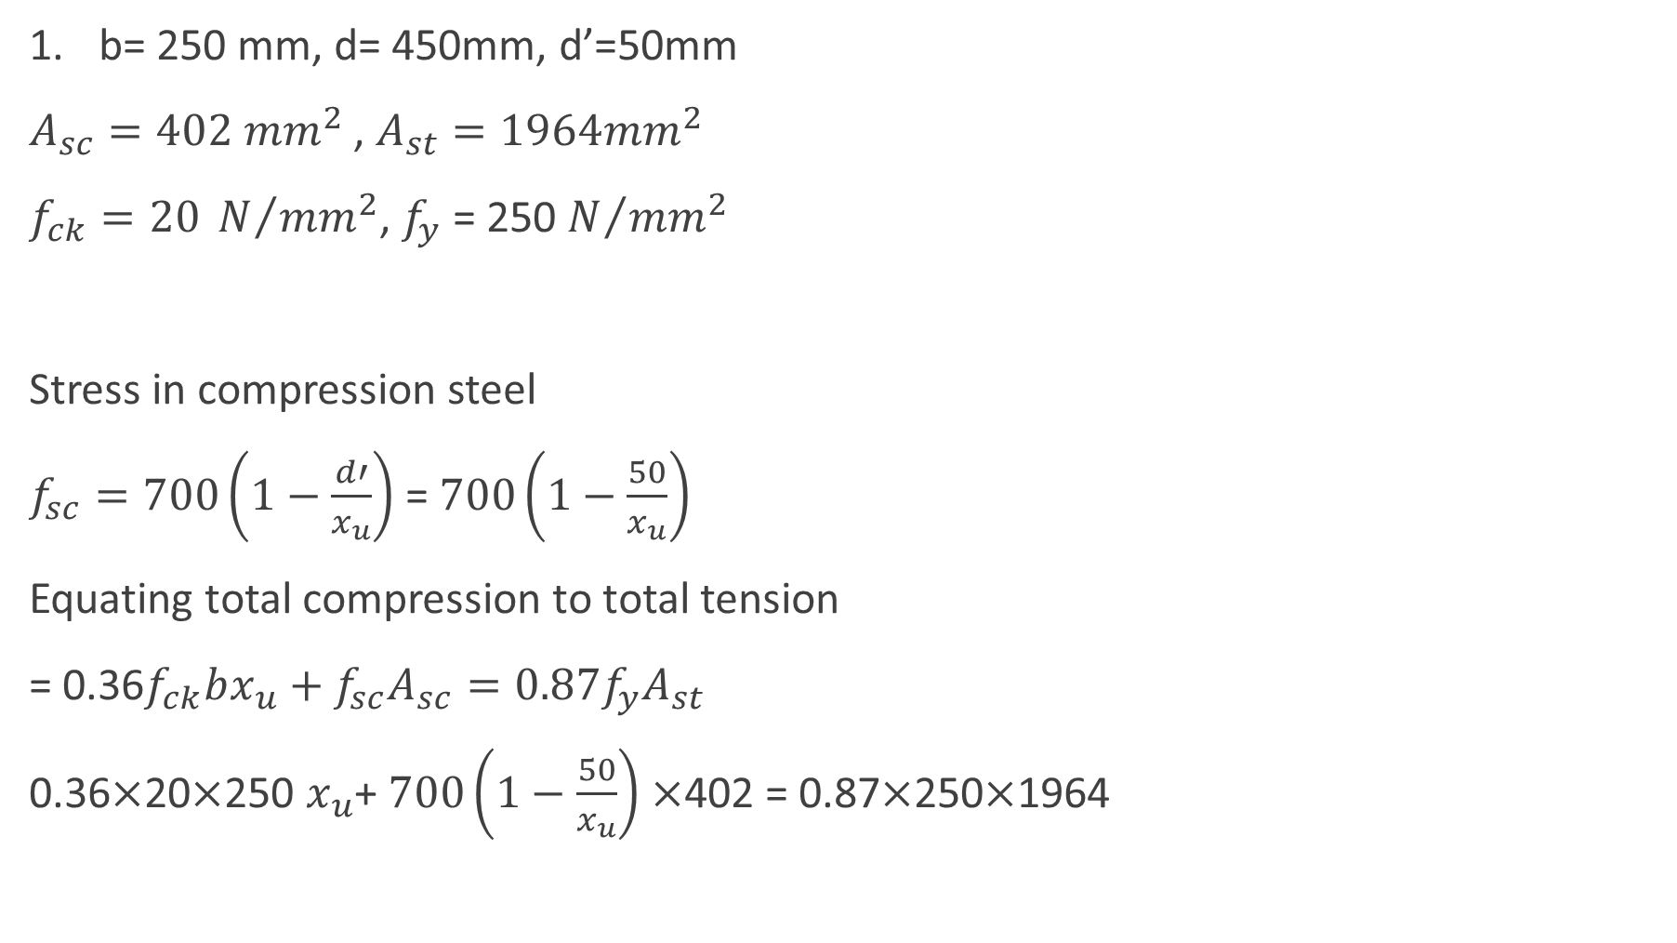
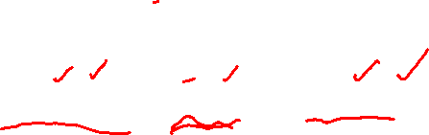
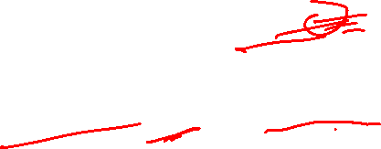
b= 250 mm, d= 450mm, d’=50mm
$A_{sc}=402 {mm}^{2}$ , $A_{st}=1964{mm}^{2}$
$f_{ck}=20 N/{{mm}^{2}}$, $f_{y}$ = 250 $N/{{mm}^{2}}$
Stress in compression steel
$f_{sc}=700\left(1−\frac{d′}{x_{u}}\right)$ = $700\left(1−\frac{50}{x_{u}}\right)$
Equating total compression to total tension
= 0.36$f_{ck}bx_{u}+f_{sc}A_{sc}=0.87f_{y}A_{st}$
0.36$×$20$×$250 $x_{u}$+ $700\left(1−\frac{50}{x_{u}}\right)×$402 = 0.87$×$250$×$1964
d’
d
d – d’
2 bars of 16 mm as compression reinforcement
4 bars of 25 mm as tensile reinforcement

Slide 14
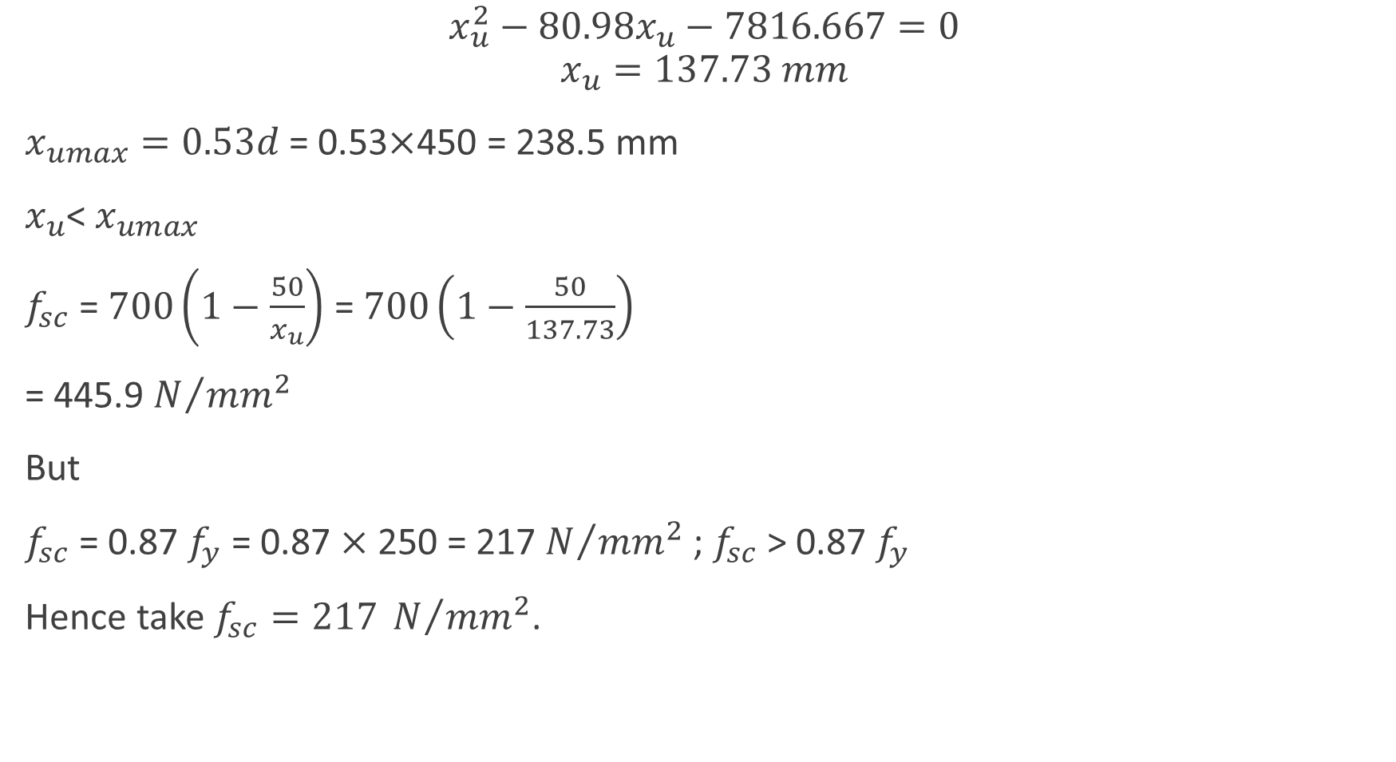
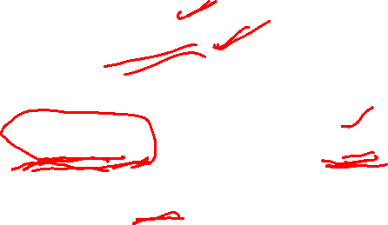

$$x_{u}^{2}−80.98x_{u}−7816.667=0$$
$$x_{u}=137.73 mm$$
$x_{umax}=0.53d$ = 0.53$×$450 = 238.5 mm
$x_{u}$< $x_{umax}$
$f_{sc}$ = $700\left(1−\frac{50}{x_{u}}\right)$ = $700\left(1−\frac{50}{137.73}\right)$
= 445.9 $N/{{mm}^{2}}$
But
$f_{sc}$ = 0.87 $f_{y}$ = 0.87 $×$ 250 = 217 $N/{{mm}^{2}}$ ; $f_{sc}$ > 0.87 $f_{y}$
Hence take $f_{sc}=217 N/{{mm}^{2}}$.

Slide 15
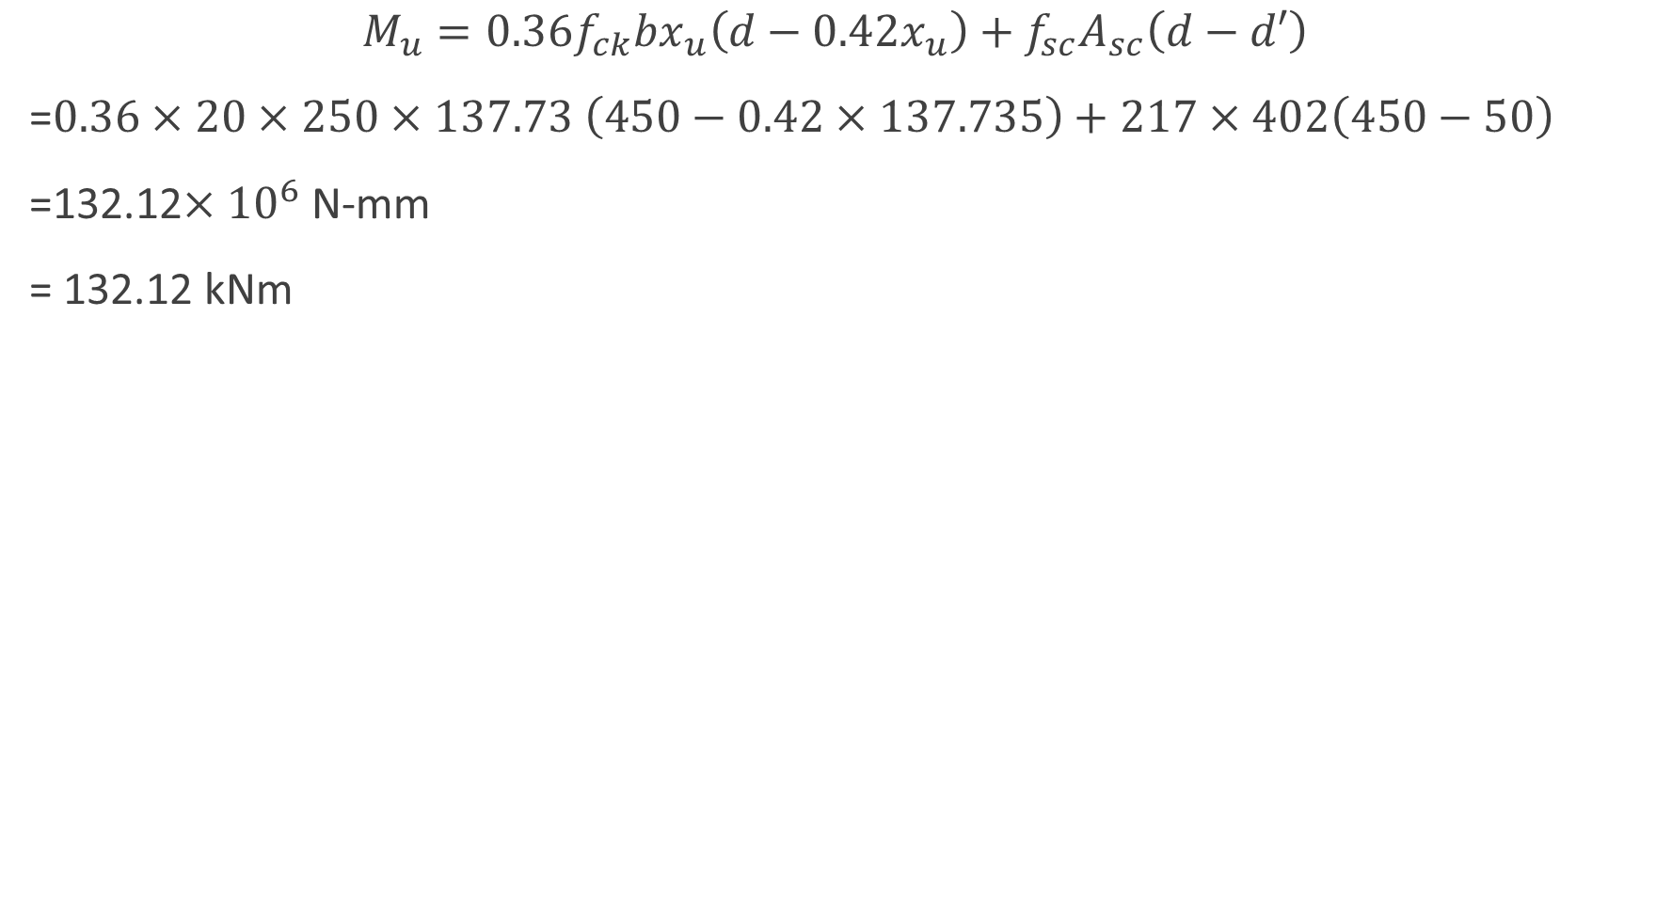
$$M_{u}=0.36f_{ck}bx_{u}\left(d−0.42x_{u}\right)+f_{sc}A_{sc}\left(d−d′\right)$$
=$0.36×20×250×137.73 \left(450−0.42×137.735\right)+217×402\left(450−50\right)$
=132.12$×{10}^{6}$ N-mm
= 132.12 kNm

Slide 16
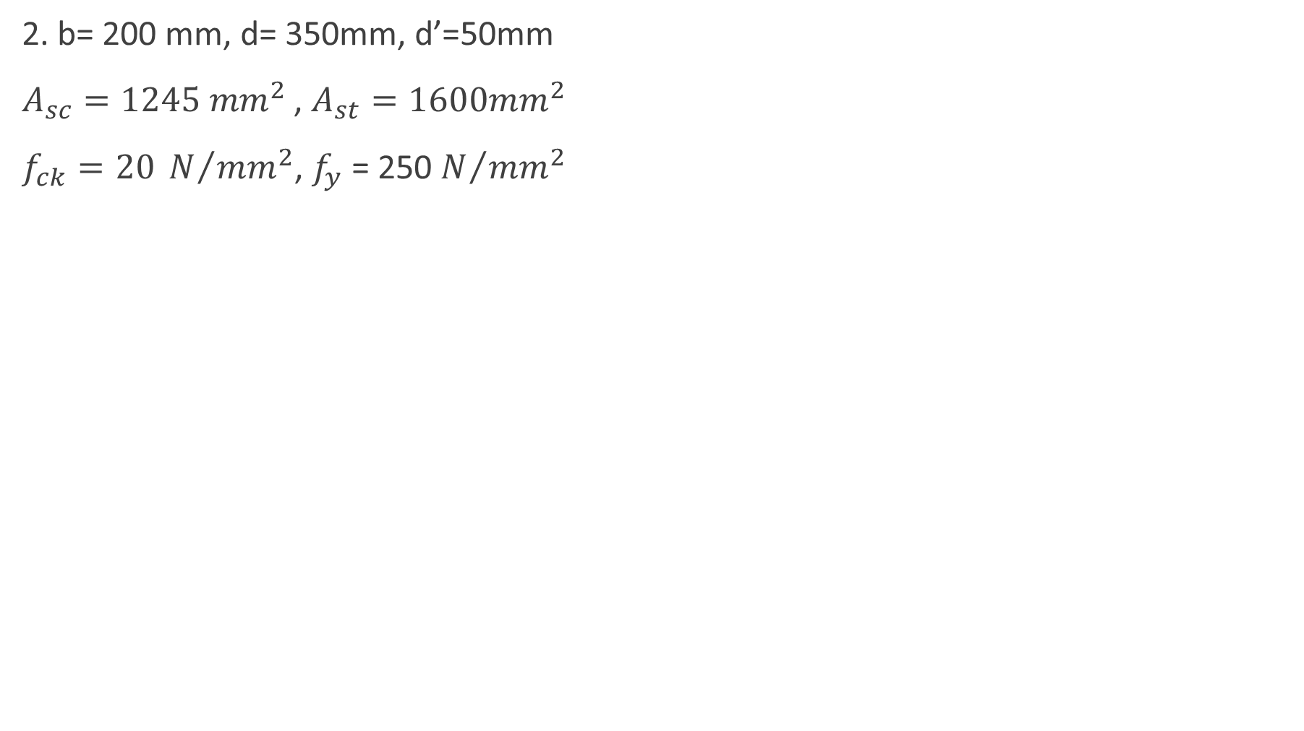
2. b= 200 mm, d= 350mm, d’=50mm
$A_{sc}=1245 {mm}^{2}$ , $A_{st}=1600{mm}^{2}$
$f_{ck}=20 N/{{mm}^{2}}$, $f_{y}$ = 250 $N/{{mm}^{2}}$
d’
d
d – d’

Slide 17
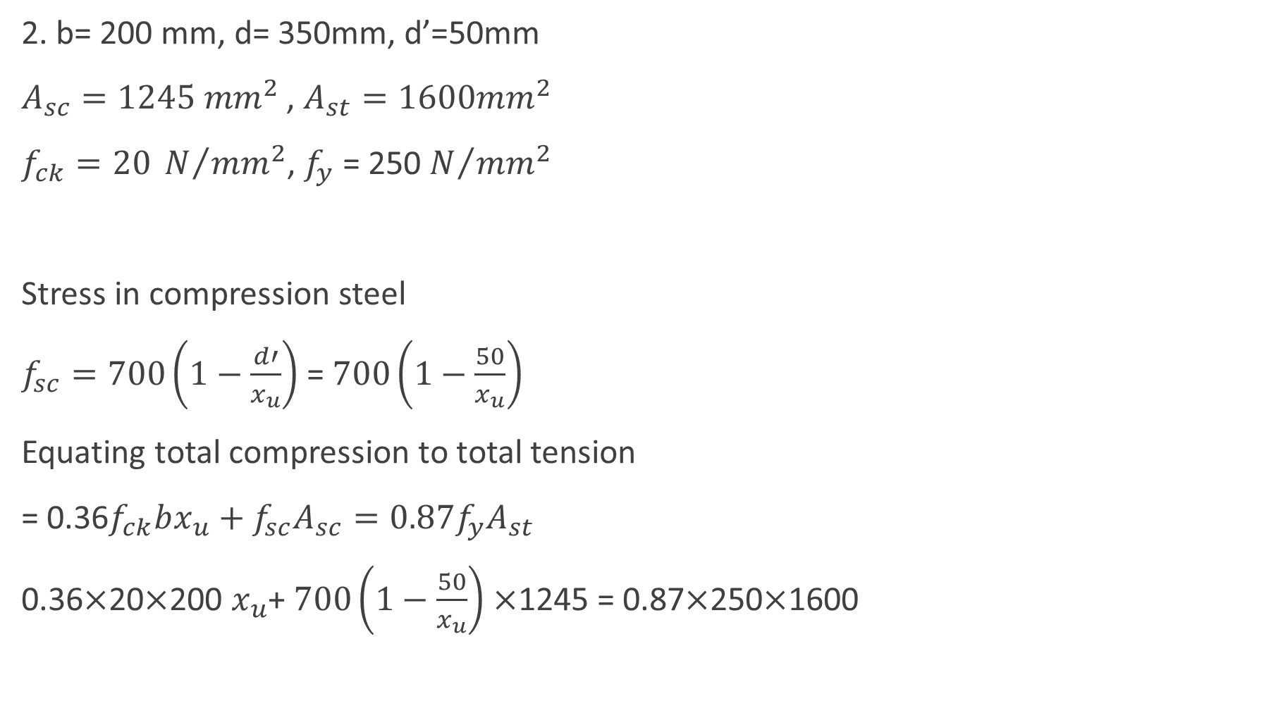
2. b= 200 mm, d= 350mm, d’=50mm
$A_{sc}=1245 {mm}^{2}$ , $A_{st}=1600{mm}^{2}$
$f_{ck}=20 N/{{mm}^{2}}$, $f_{y}$ = 250 $N/{{mm}^{2}}$
Stress in compression steel
$f_{sc}=700\left(1−\frac{d′}{x_{u}}\right)$ = $700\left(1−\frac{50}{x_{u}}\right)$
Equating total compression to total tension
= 0.36$f_{ck}bx_{u}+f_{sc}A_{sc}=0.87f_{y}A_{st}$
0.36$×$20$×$200 $x_{u}$+ $700\left(1−\frac{50}{x_{u}}\right)×$1245 = 0.87$×$250$×$1600
d’
d
d – d’

Slide 18
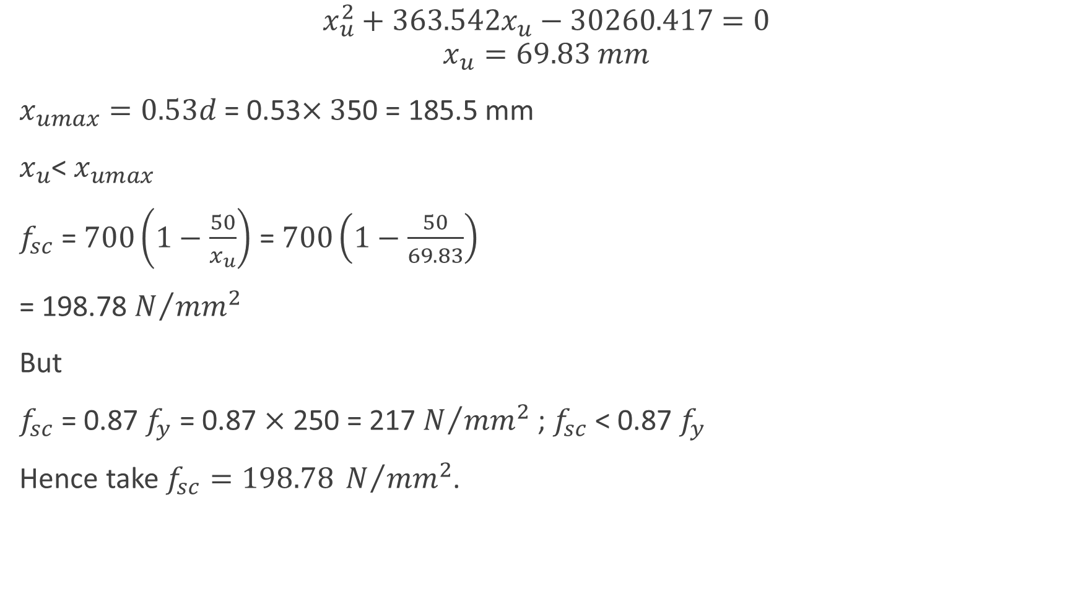
$$x_{u}^{2}+363.542x_{u}−30260.417=0$$
$$x_{u}=69.83 mm$$
$x_{umax}=0.53d$ = 0.53$×3$50 = 185.5 mm
$x_{u}$< $x_{umax}$
$f_{sc}$ = $700\left(1−\frac{50}{x_{u}}\right)$ = $700\left(1−\frac{50}{69.83}\right)$
= 198.78 $N/{{mm}^{2}}$
But
$f_{sc}$ = 0.87 $f_{y}$ = 0.87 $×$ 250 = 217 $N/{{mm}^{2}}$ ; $f_{sc}$ < 0.87 $f_{y}$
Hence take $f_{sc}=198.78 N/{{mm}^{2}}$.

Slide 19
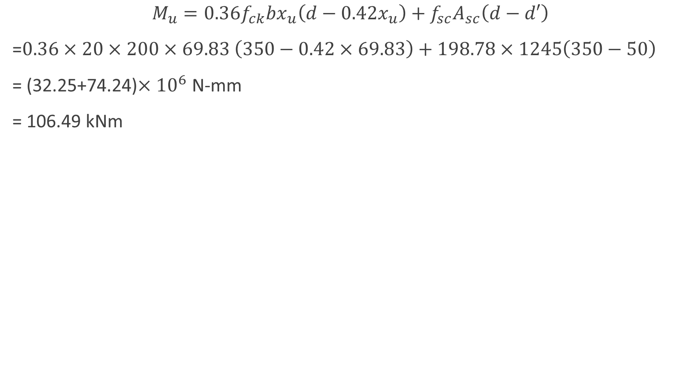
$$M_{u}=0.36f_{ck}bx_{u}\left(d−0.42x_{u}\right)+f_{sc}A_{sc}\left(d−d′\right)$$
=$0.36×20×200×69.83 \left(350−0.42×69.83\right)+198.78×1245\left(350−50\right)$
= (32.25+74.24)$×{10}^{6}$ N-mm
= 106.49 kNm

Slide 20
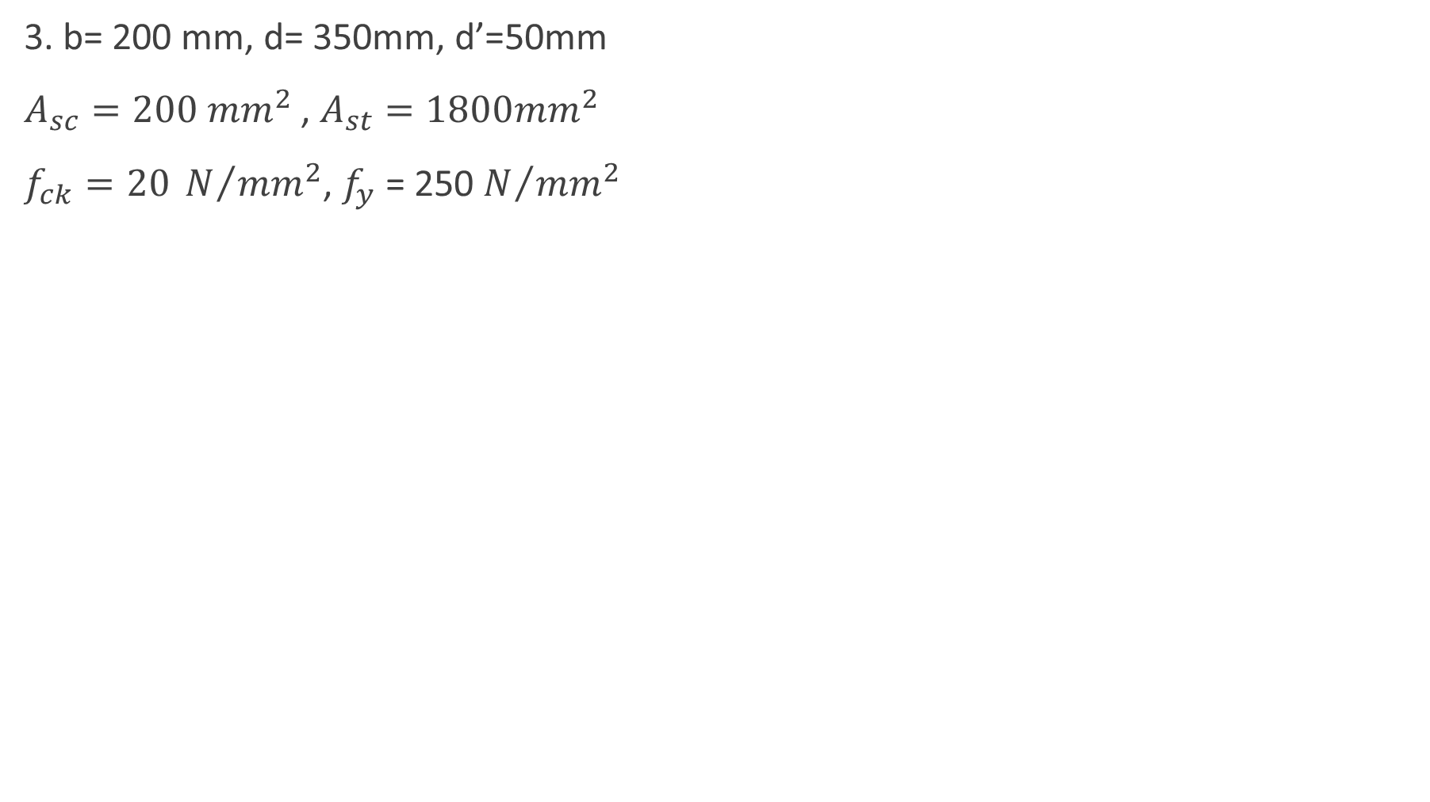
3. b= 200 mm, d= 350mm, d’=50mm
$A_{sc}=200 {mm}^{2}$ , $A_{st}=1800{mm}^{2}$
$f_{ck}=20 N/{{mm}^{2}}$, $f_{y}$ = 250 $N/{{mm}^{2}}$
d’
d
d – d’

Slide 21
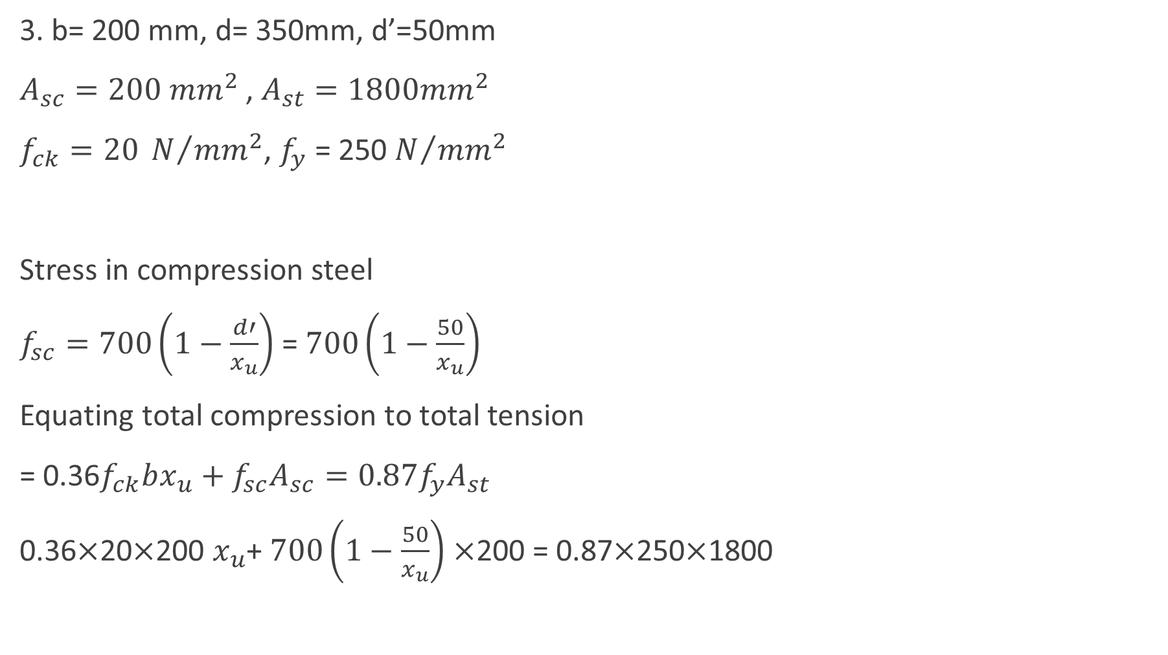
3. b= 200 mm, d= 350mm, d’=50mm
$A_{sc}=200 {mm}^{2}$ , $A_{st}=1800{mm}^{2}$
$f_{ck}=20 N/{{mm}^{2}}$, $f_{y}$ = 250 $N/{{mm}^{2}}$
Stress in compression steel
$f_{sc}=700\left(1−\frac{d′}{x_{u}}\right)$ = $700\left(1−\frac{50}{x_{u}}\right)$
Equating total compression to total tension
= 0.36$f_{ck}bx_{u}+f_{sc}A_{sc}=0.87f_{y}A_{st}$
0.36$×$20$×$200 $x_{u}$+ $700\left(1−\frac{50}{x_{u}}\right)×$200 = 0.87$×$250$×$1800
d’
d
d – d’

Slide 22
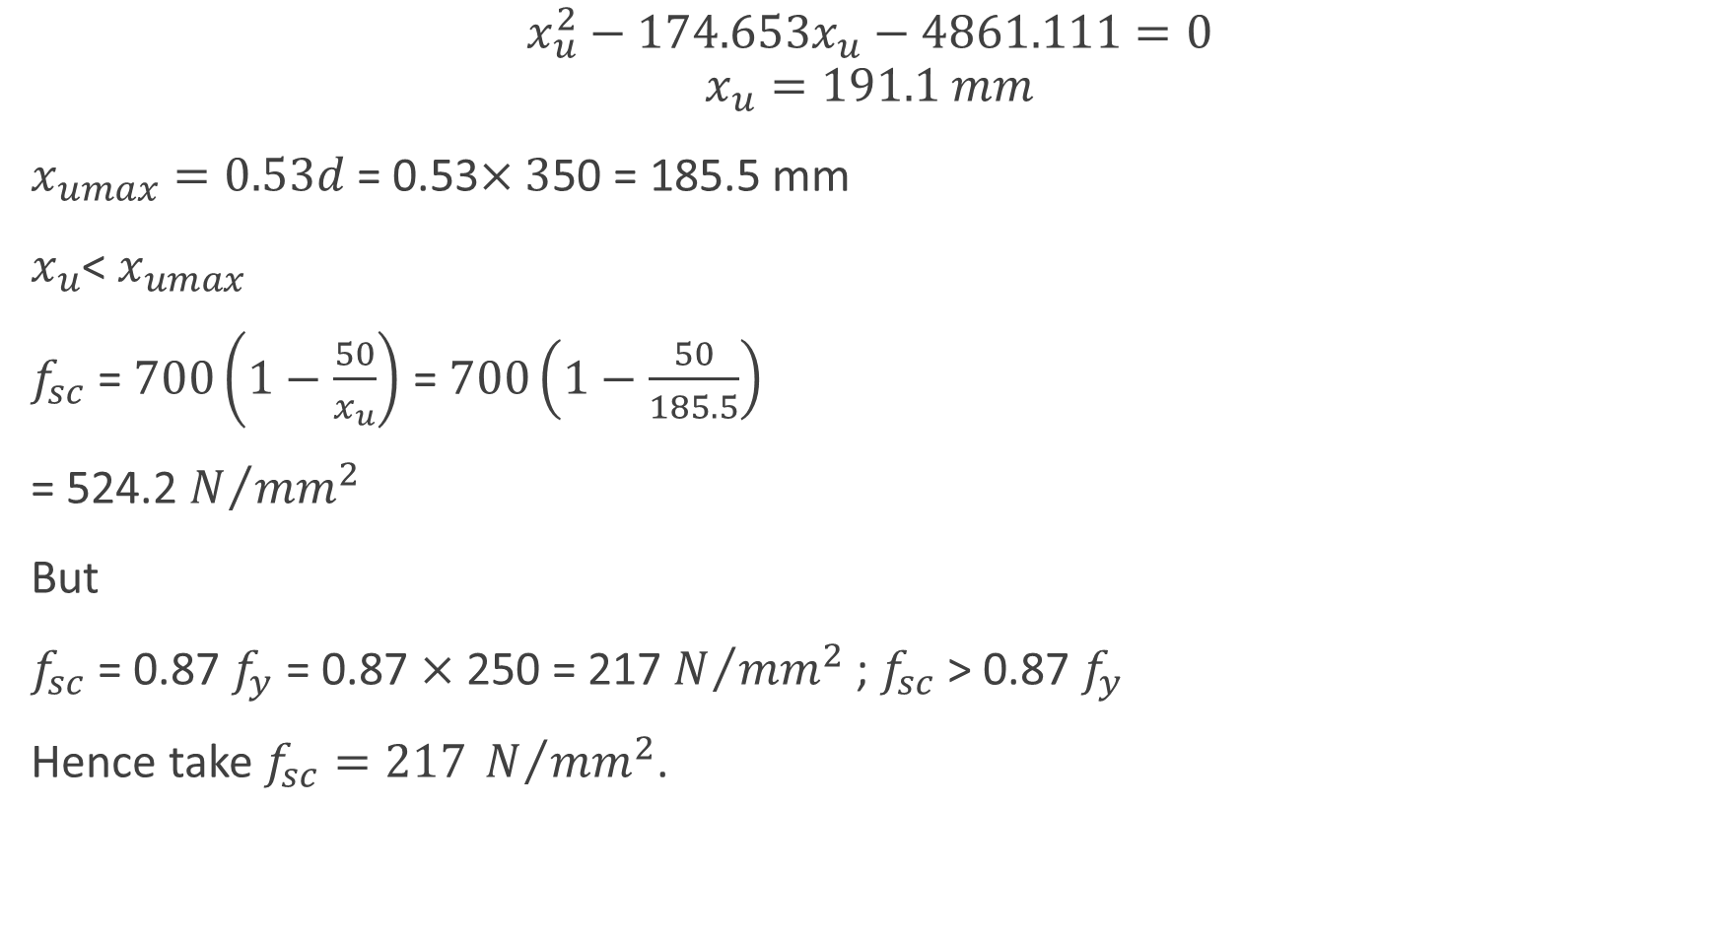
$$x_{u}^{2}−174.653x_{u}−4861.111=0$$
$$x_{u}=191.1 mm$$
$x_{umax}=0.53d$ = 0.53$×3$50 = 185.5 mm
$x_{u}$< $x_{umax}$
$f_{sc}$ = $700\left(1−\frac{50}{x_{u}}\right)$ = $700\left(1−\frac{50}{185.5}\right)$
= 524.2 $N/{{mm}^{2}}$
But
$f_{sc}$ = 0.87 $f_{y}$ = 0.87 $×$ 250 = 217 $N/{{mm}^{2}}$ ; $f_{sc}$ > 0.87 $f_{y}$
Hence take $f_{sc}=217 N/{{mm}^{2}}$.

Slide 23
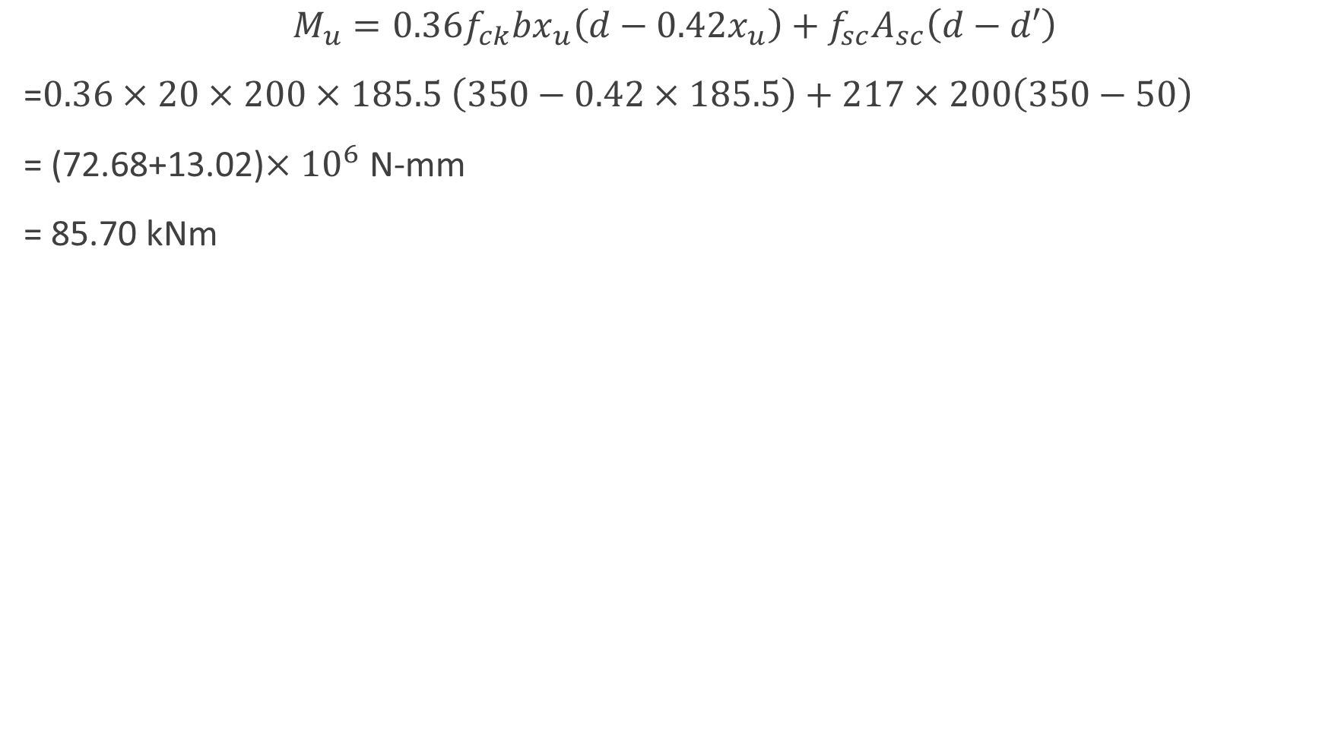
$$M_{u}=0.36f_{ck}bx_{u}\left(d−0.42x_{u}\right)+f_{sc}A_{sc}\left(d−d′\right)$$
=$0.36×20×200×185.5 \left(350−0.42×185.5\right)+217×200\left(350−50\right)$
= (72.68+13.02)$×{10}^{6}$ N-mm
= 85.70 kNm

Slide 24
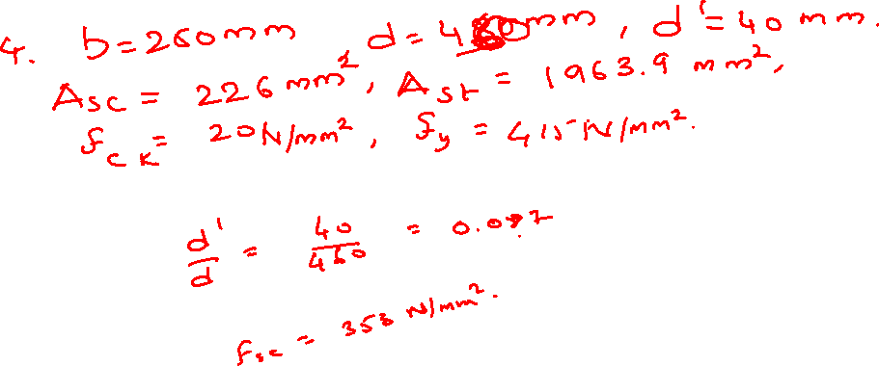

Slide 25
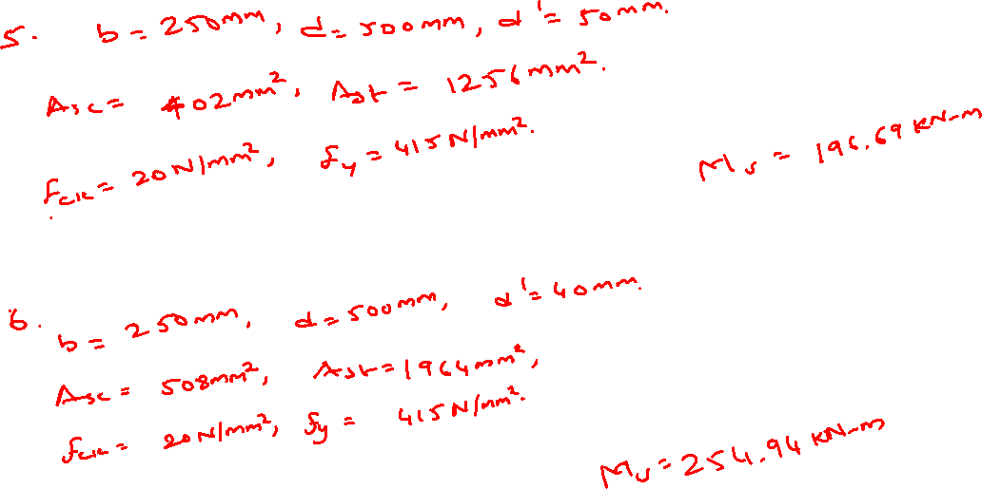

Slide 26
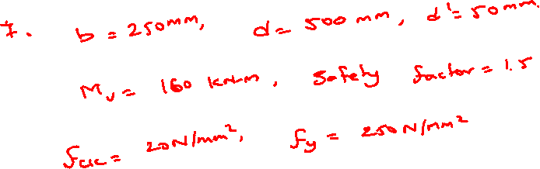
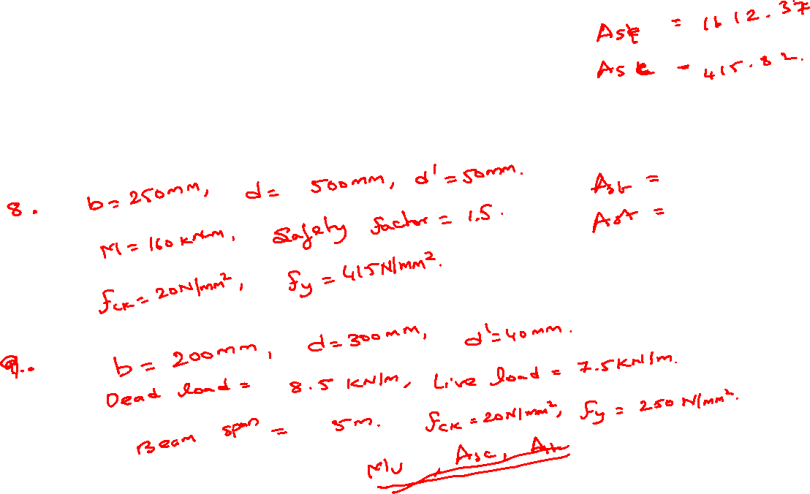

Slide 27
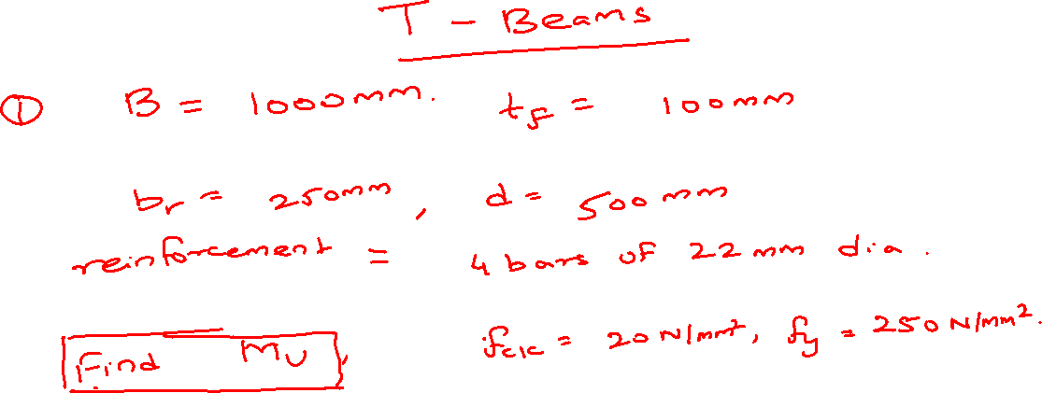

Slide 28
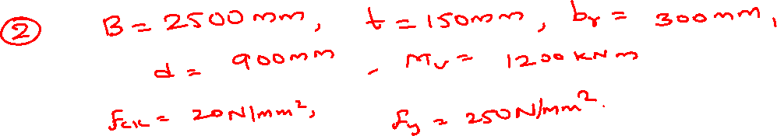
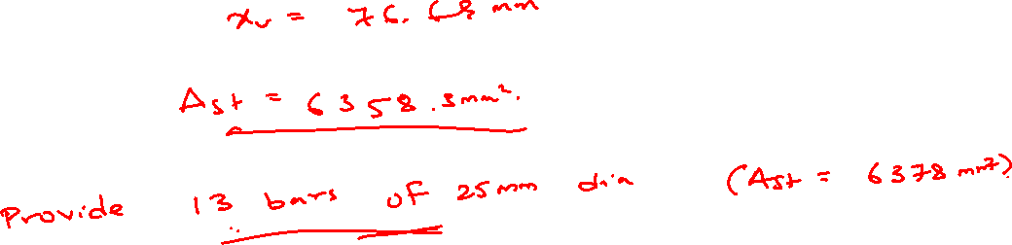

Slide 29
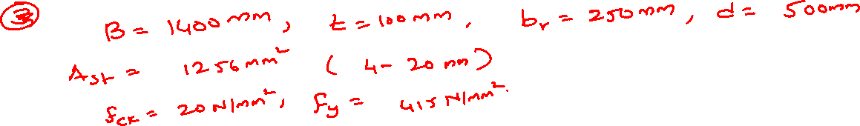
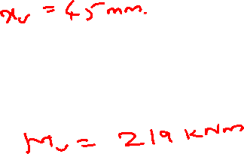

Slide 30
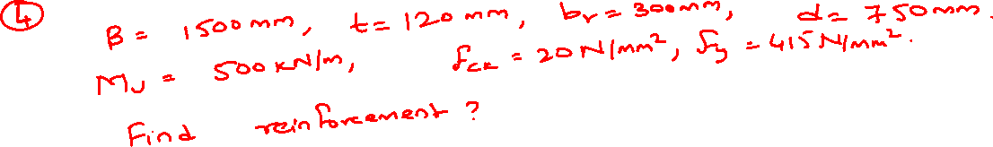
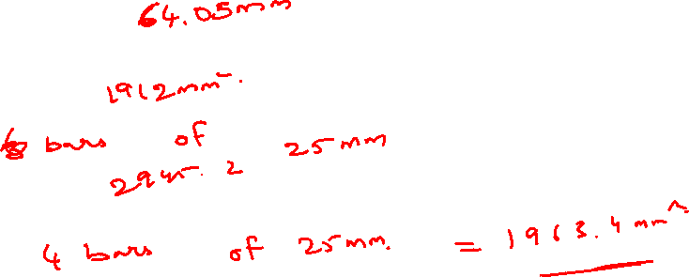
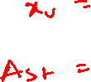

Slide 31
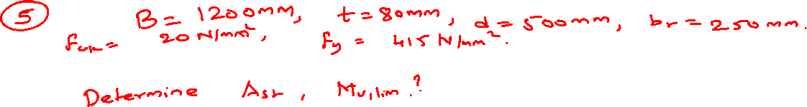
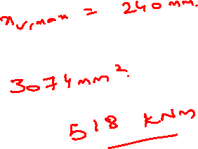
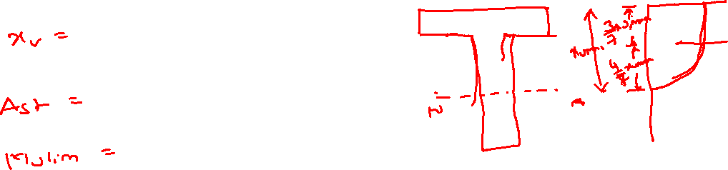

Slide 32
